Slide 1
Expense report

Slide 2
Expense Details for the month of June

Slide 3
How much is spent for each category (Pivot Table)

Slide 5
VISUALLY REPRESENT THE AMOUNT SPENT AGAINST EACH CATEGORY IS WHAT PERCENTAGE OF THE TOTAL EXPENSE AMOUNT(PIVOT CHART)

Slide 7
How much is spent on different items of each category (Pivot Table)

Slide 8
Row Labels | Sum of Expense (INR)
Entertainment | 1000
Movie | 1000
Ticket and Bills | 2570
Electricity bill | 370
Gas | 850
House help | 1000
Railway monthly ticket | 350
Grand Total | 3570

Slide 9
Visually represent the amount spent on different items of Entertainment and Tickets and bills category (Pivot Chart)

Slide 11
How many times money has been spent against different items of each category (Pivot Table)

Slide 12
Row Labels | Count of Expense (INR)
Doctor and Medicine | 1
Entertainment | 4
Food | 6
Grocery | 15
Miscellaneous | 1
Shopping | 2
Ticket and Bills | 4
Grand Total | 33

Slide 13
WHAT AMOUNT IS SPENT ON EACH ITEM OF THE CATEGORIES WITH HIGHEST AND 2ND HIGHEST EXPENSE AMOUNT(PIVOT TABLE)

Slide 14
Row Labels | Sum of Expense (INR)
Grocery | 2740
Vegetables | 1690
Foodgrains and cereals | 1050
Shopping | 3500
Tshirt and Jeans | 2500
Shoes | 1000
Grand Total | 6240

Slide 15
VISUALLY REPRESENT THE DATA WITH DATA BARS (CONDITIONAL FORMATTING)

Slide 16
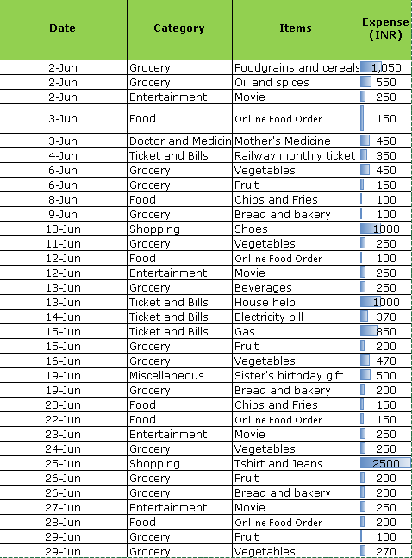

Slide 17
Expense Details for last 6 months

Slide 18
Month-wise trend of expenses (Pivot table and chart)

Slide 19
Row Labels | Sum of Expense (INR)
January | 13900
February | 15620
March | 13140
April | 14800
May | 13370
June | 13560
Grand Total | 84390

Slide 21
Find out the month Nitin spent the most

Slide 22
Row Labels | Sum of Expense (INR)
February | 15620
Grand Total | 15620

Slide 23
Category wise expenses (Pivot table)

Slide 24
Row Labels | Sum of Expense (INR)
Grocery | 30990
Ticket and Bills | 16040
Entertainment | 12000
Shopping | 8700
Miscellaneous | 7720
Food | 4940
Doctor and Medicine | 4000
Grand Total | 84390

Slide 25
Visually represent it with data bars to display categories with the highest and lowest expense amount

Slide 26
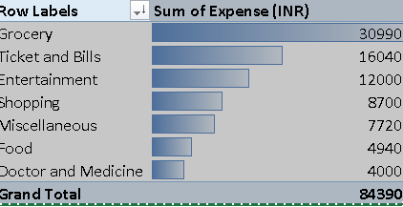

Slide 27
Month-wise expense of each category (Pivot table)

Slide 28
Sum of Expense (INR) | Column Labels
Row Labels | January | February | March | April | May | June | Grand Total
Doctor and Medicine | 1750 | 450 | 450 | 450 | 450 | 450 | 4000
Entertainment | 250 | 7500 | 500 | 1250 | 1500 | 1000 | 12000
Food | 1900 |  | 800 | 1390 |  | 850 | 4940
Grocery | 4500 | 4300 | 6090 | 5460 | 5950 | 4690 | 30990
Miscellaneous | 850 | 720 | 850 | 3500 | 1300 | 500 | 7720
Shopping | 2000 |  | 1700 |  | 1500 | 3500 | 8700
Ticket and Bills | 2650 | 2650 | 2750 | 2750 | 2670 | 2570 | 16040
Grand Total | 13900 | 15620 | 13140 | 14800 | 13370 | 13560 | 84390

Slide 29
Find out 2 categories with higher expenses for each of the 6 months

Slide 30
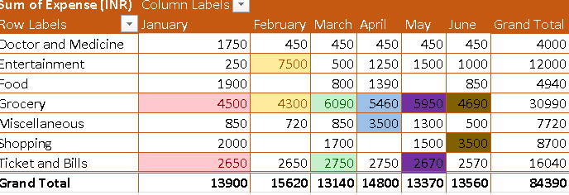

Slide 31
How much is spent in each month against different items of Entertainment, Food and Shopping categories (Pivot table)

Slide 32
Sum of Expense (INR) | Column Labels
Row Labels | Entertainment | Food | Shopping | Grand Total
January | 250 | 1900 | 2000 | 4150
February | 7500 |  |  | 7500
March | 500 | 800 | 1700 | 3000
April | 1250 | 1390 |  | 2640
May | 1500 |  | 1500 | 3000
June | 1000 | 850 | 3500 | 5350
Grand Total | 12000 | 4940 | 8700 | 25640

Slide 33
Find out which months have the highest amount spent for movies and dining out

Slide 34
Sum of Expense (INR) | Column Labels
Row Labels | January | March | April | May | June | Grand Total
Dining out | 1000 | 800 | 850 |  |  | 2650
Movie | 250 | 500 | 250 | 500 | 1000 | 2500
Grand Total | 1250 | 1300 | 1100 | 500 | 1000 | 5150

Slide 35
Decide on the essential and less essential items and analyse the expenses
Recommend how can Nitin increase his savings

Slide 36
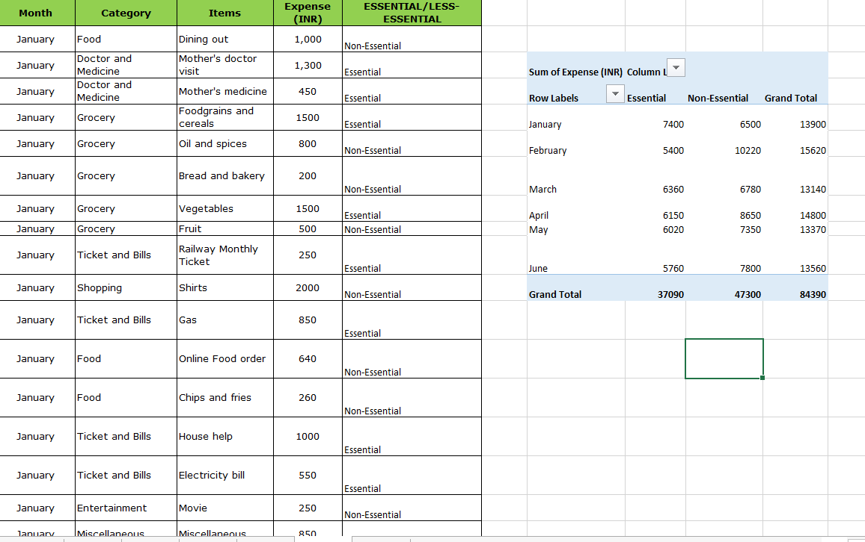

Slide 37
Action Plan:
1. Set a Budget:
Establish monthly budgets for categories like food, entertainment, and miscellaneous expenses. Track expenses regularly to ensure adherence.
2. Monitor and Adjust:
Regularly review spending patterns and adjust the budget as needed. Use budgeting tools or apps to track and manage expenses effectively.
3. Increase Income:
Explore opportunities for additional income, such as freelance work or part-time jobs, to boost savings.
By focusing on reducing less essential expenses and optimizing essential spending, Nitin can effectively increase his savings over time.

Slide 38
Done By
Sai Balaji Valluru
ADDE RAHUL
KANUKUTLA ALEKHYA
THIMMAPURAM SURENDAR GOUD
Karthik

